Slide 1

LJ school of computer applications SEM 08 Fundamental of Data science Presentation

Slide 2
Crypto EDA Analysis, Prediction & forecasting
Members:
Guided by:
Dr. Jignesh Doshi
Name | Enrolment no.
Arnold Macwan | 21004500210065
Manthan Parmar | 21004500210094
Hitij Vaghela | 21004500210186

Slide 3
Table of content
Introduction & Problem definition
Data Summary
EDA analysis
Scatter plot
Heatmap & histogram
Feature engineering
Moving averages
BB bands
Daily change & ATR
RSI
XGBoost model
LSTM Model
Conclusion

Slide 4
Problem definition
Cryptocurrency markets are characterized by significant volatility and are affected by numerous elements. This project aims to create a predictive model capable of delivering precise price predictions, assisting users in refining their trading strategies and make decisions and predict the trends (up/down) and useful insights using past market data, technical indicators and other factors

Slide 5
About data
The "Cryptocurrency Price Analysis Dataset: BTC, ETH, XRP, LTC (2018-2023)" is a comprehensive dataset that captures the daily price movements of six popular cryptocurrencies. It covers a period from January 1, 2018, to May 31, 2023, providing a valuable resource for researchers, analysts, and enthusiasts interested in studying the historical price behavior of these digital assets.
https://www.kaggle.com/datasets/adityamhaske/cryptocurrency-price-analysis-dataset/data

Slide 6
Column descriptions
List of features:
Crypto: This column specifies the name of the cryptocurrency
Date: The date on which the price data was recorded.
Open: The opening price of the cryptocurrency at the beginning of the day.
High: The highest price reached by the cryptocurrency during the day.
Low: The lowest price reached by the cryptocurrency during the day.
Close: The closing price of the cryptocurrency at the end of the day.

Slide 7
Used libraries
Numpy and pandas
Sci-kit learn
Tensorflow
Matplotlib
seaborn

Slide 8
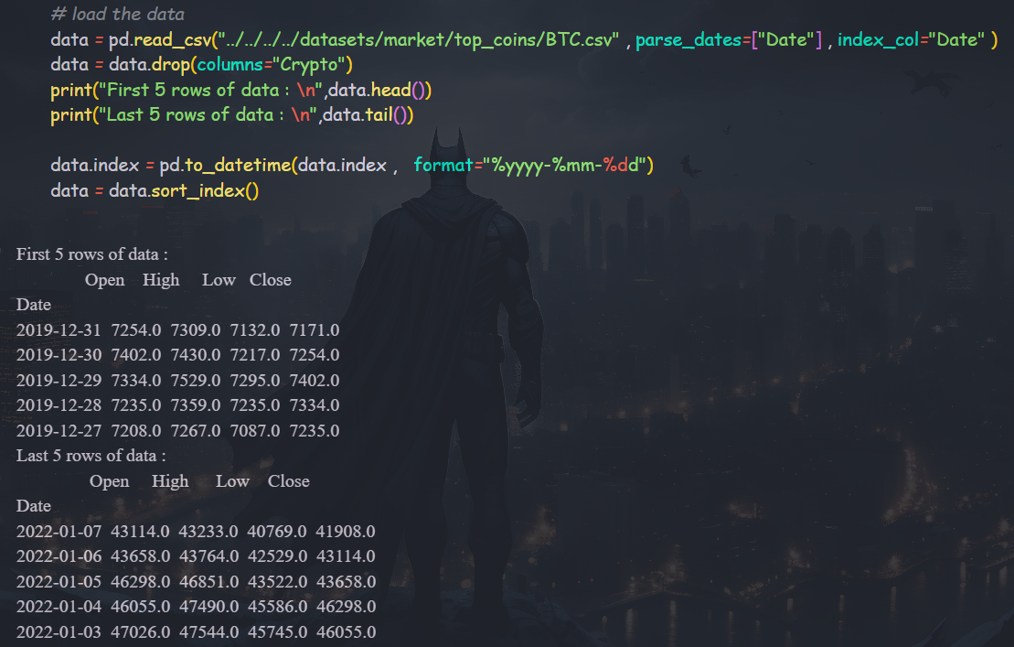
Data collection

Slide 9
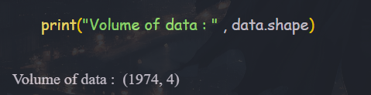
Volume of data
Rows :1974
Columns: 4

Slide 10
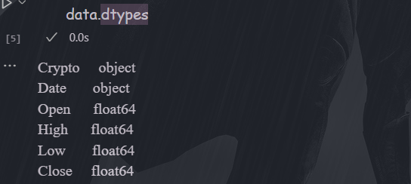
Column types

Slide 11
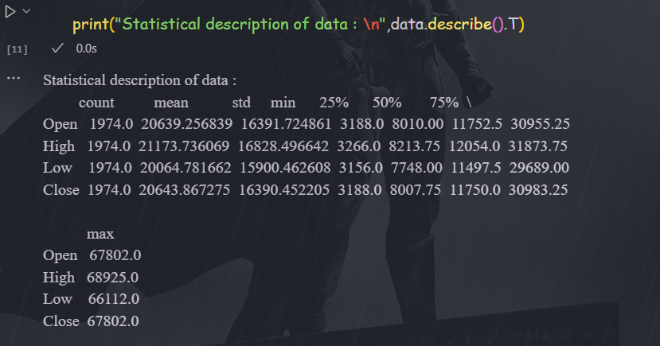
Statistical summary

Slide 12
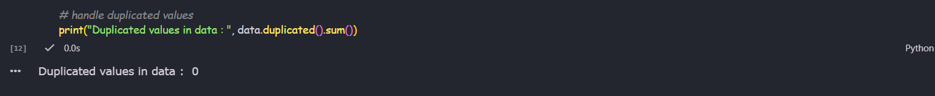
Handle duplicated values

Slide 13
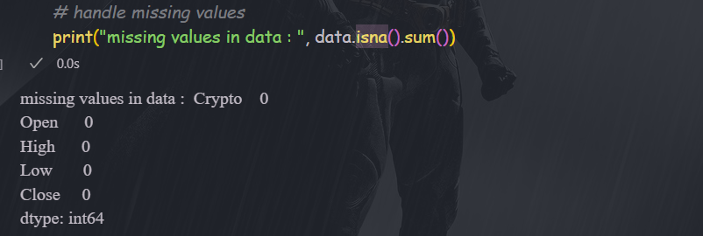
Check for missing values

Slide 14

EDA analysis

Slide 15
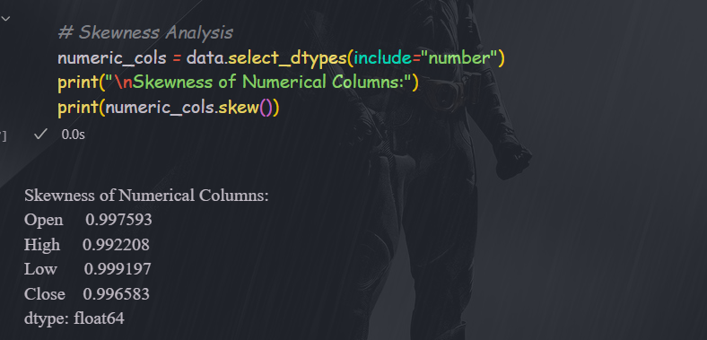
Skewness Analysis

Slide 16

Histogram for numerical cols

Slide 17
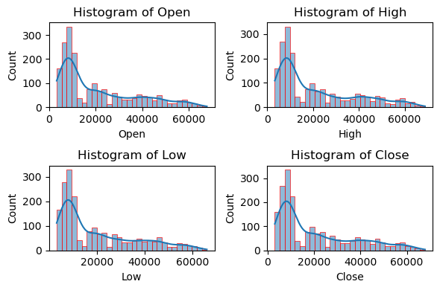

Slide 18
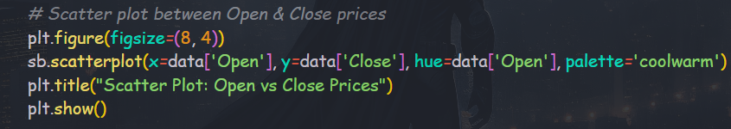
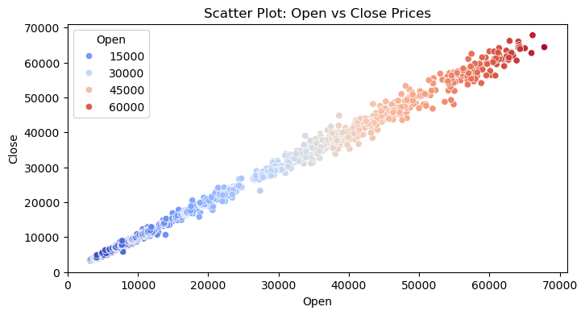
Scatter plot : open vs close

Slide 19
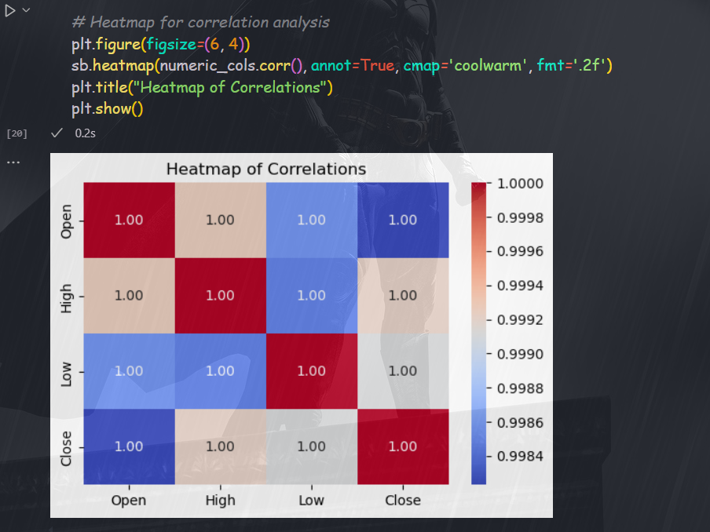
Heatmap for correlation analysis

Slide 20
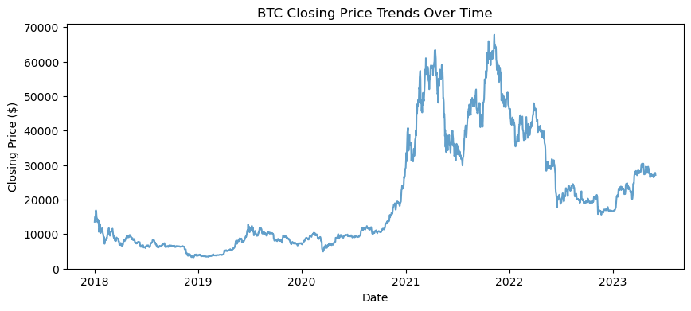
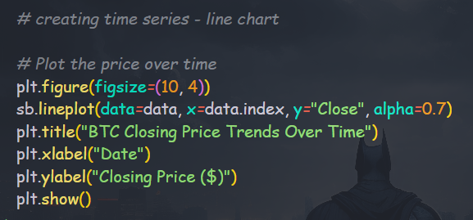
Price-chart : line chart analysis

Slide 21
Feature engineering and indicators
Add following features to indicate the trends
Moving average
Moving averages are technical indicators that smooth out price fluctuations by averaging prices over a specific period, helping traders to identify trends and potential support/resistance levels.
Daily Change %
Daily change shows the daily average changes in the price in percentage
Bollinger bands
Bollinger Bands are a technical analysis tool used to assess market volatility and identify potential trading opportunities, consisting of a simple moving average (SMA) and two bands (upper and lower) typically set two standard deviations away from the SMA.
ATR
The Average True Range (ATR) indicator is a technical analysis tool that measures market volatility.
RSI
The RSI provides immediate signals for buying and selling, helping you understand whether an asset is overbought or oversold.

Slide 22
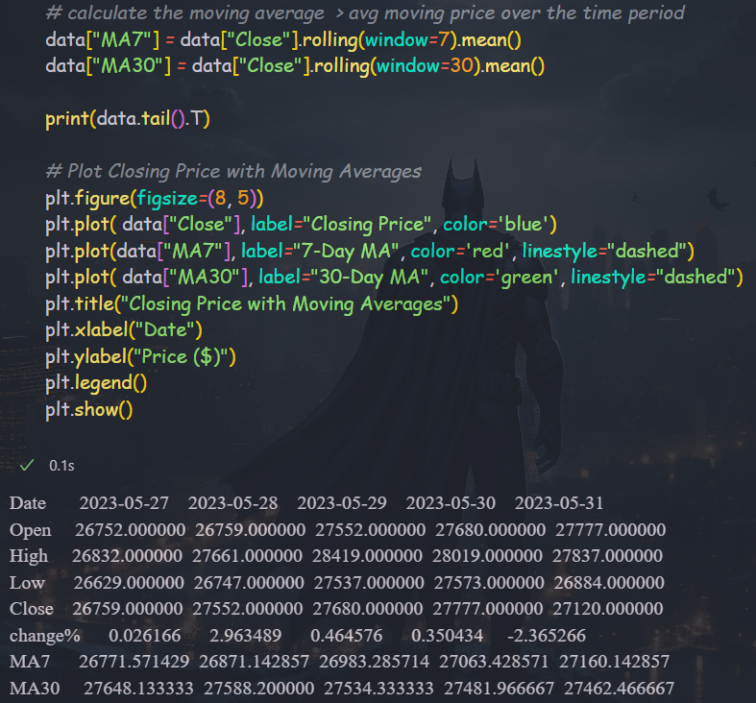
Moving averages

Slide 23
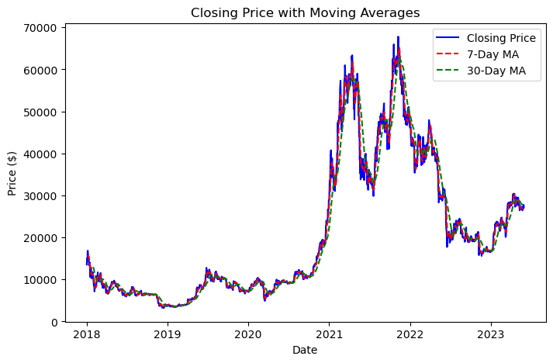
Visualizing the moving averages

Slide 24
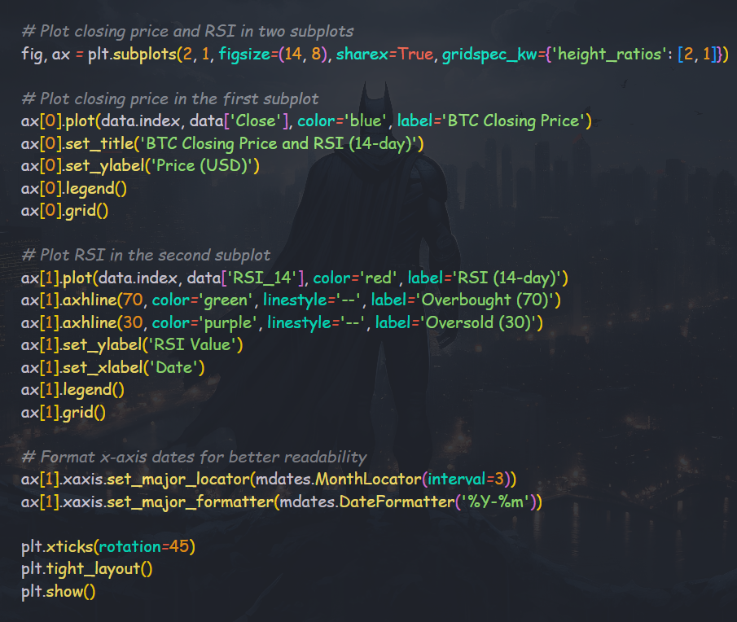
RSI – Relative strength index

Slide 25
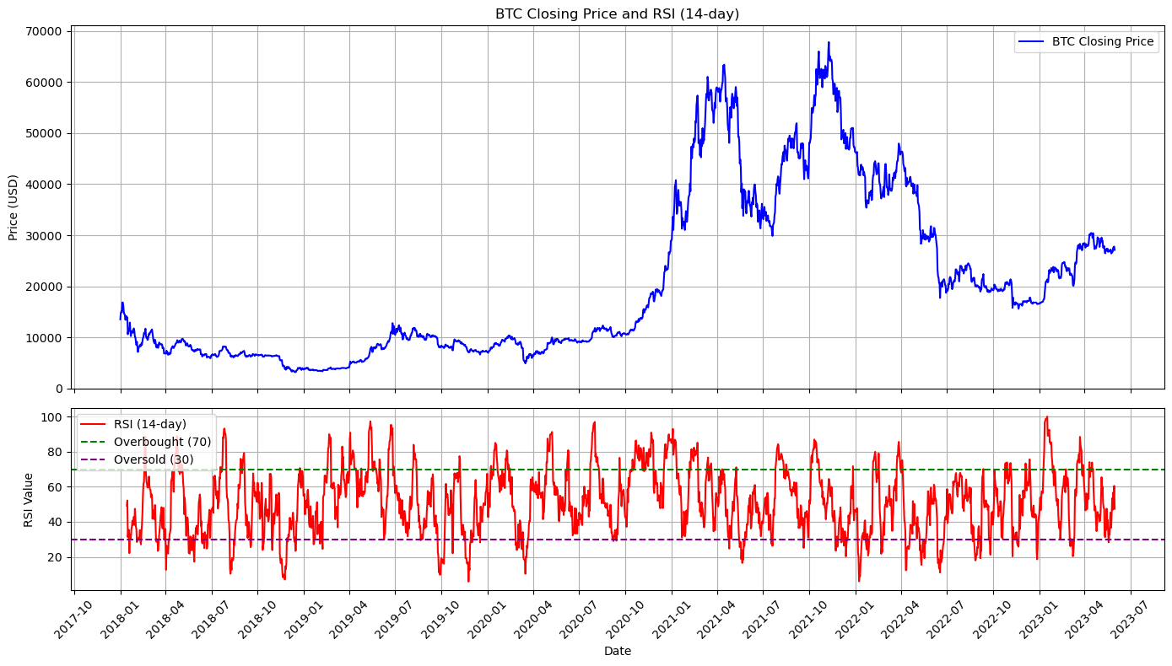

Slide 26
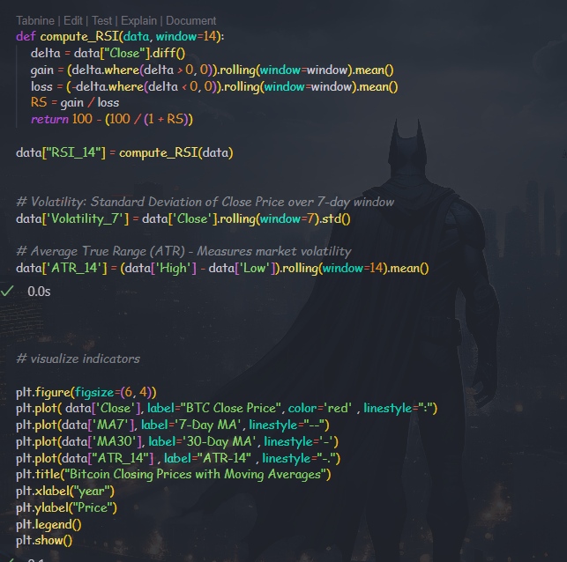
Other indicators

Slide 27
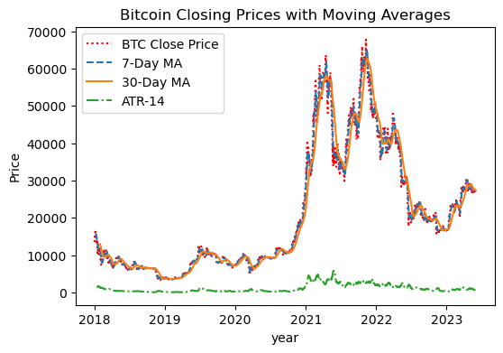
Visualizing the indicators

Slide 28
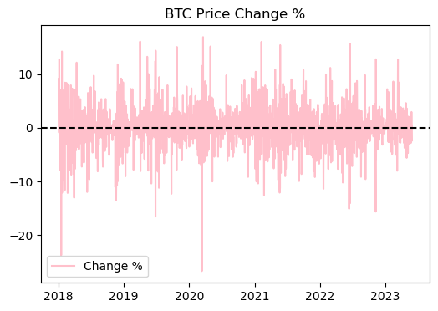
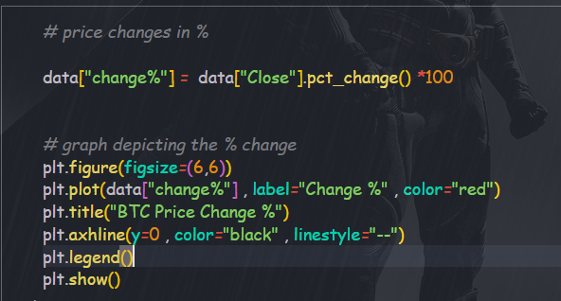
Percentage changes in price

Slide 29
Bollinger Bands
Bollinger Bands are a technical analysis tool that shows the price volatility of a financial instrument over time. It consists of three : upper band, lower band and middle band
In this case :
Upper band = MA30 + (2 * Std Dev.)
Lower band = MA30 - (2 * Std Dev.)
Middle band = MA30

Slide 30
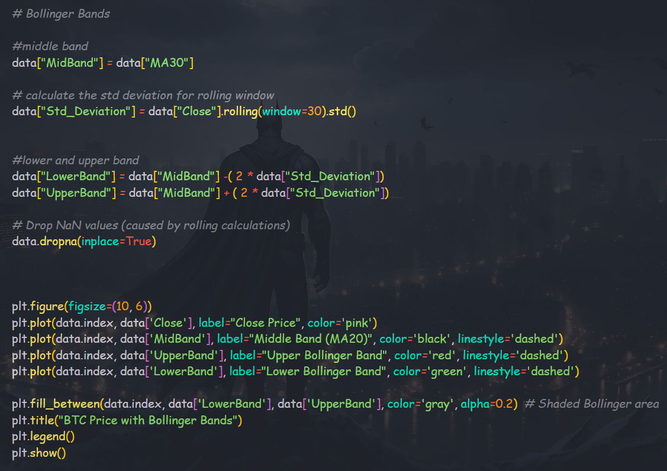

Slide 31
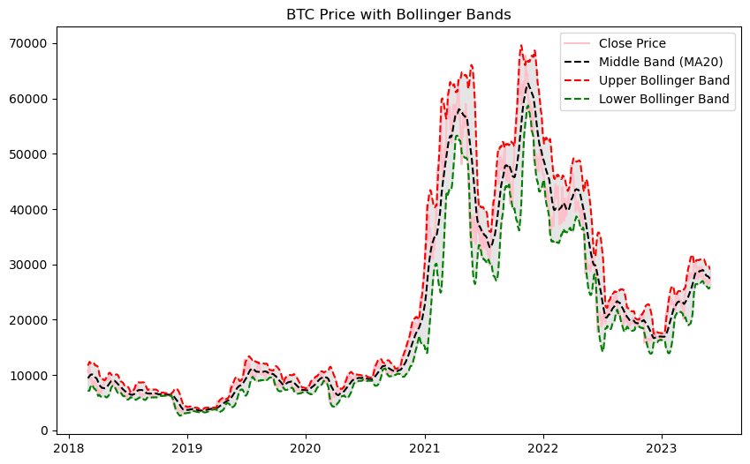
Visualizing the Bollinger's bands

Slide 32
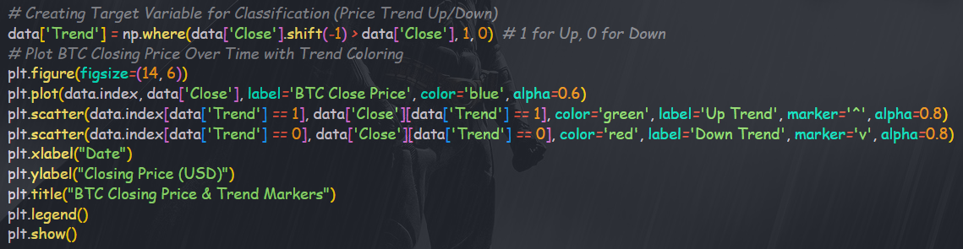
Identifying the trends with plot

Slide 33
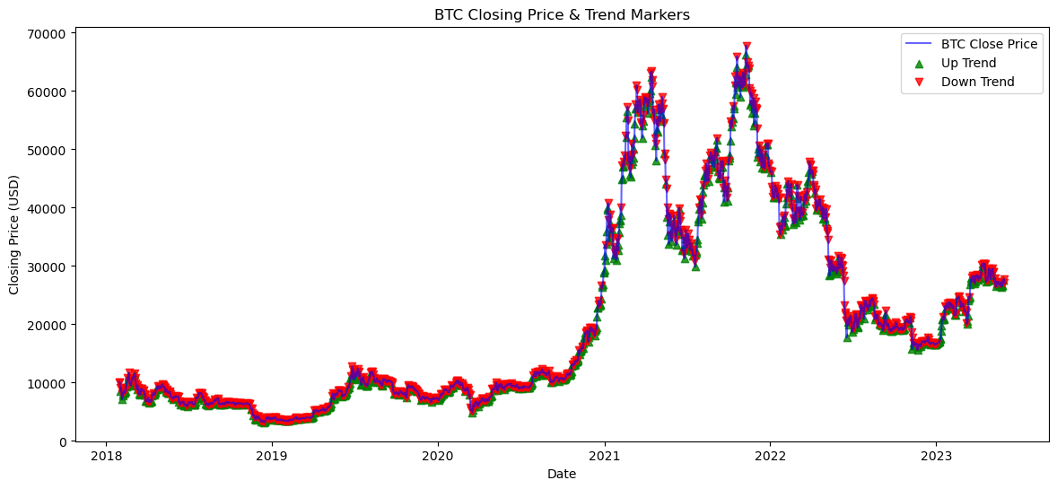

Slide 34
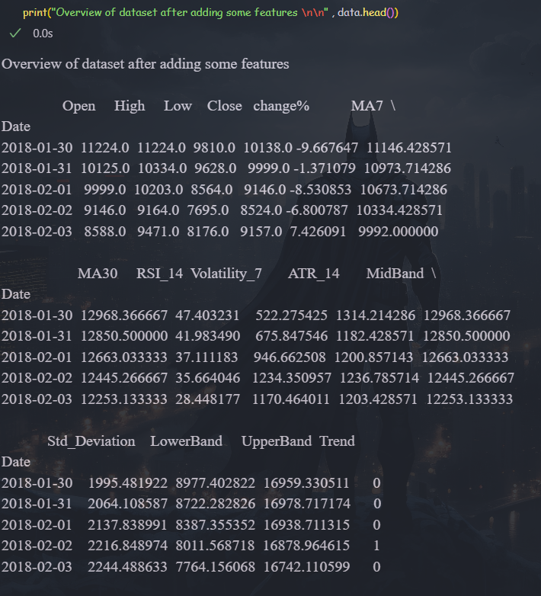
Overview of dataset after EDA

Slide 35
Price Prediction with advance models
XGBRegressor:
The XGBoost Regressor is a powerful machine learning algorithm that is commonly used for regression tasks. It is an optimized gradient boosting framework that uses tree-based learning and is known for its high performance and speed.
XGBoost uses gradient boosting, where decision trees are built sequentially, and each tree tries to correct the errors made by the previous tree.
LSTM
LSTM (Long Short-Term Memory) is a type of recurrent neural network (RNN) designed to process and predict sequential data, addressing the limitations of traditional RNNs by overcoming the problem of vanishing gradients.

Slide 36

XGBoost Regressor

Slide 37
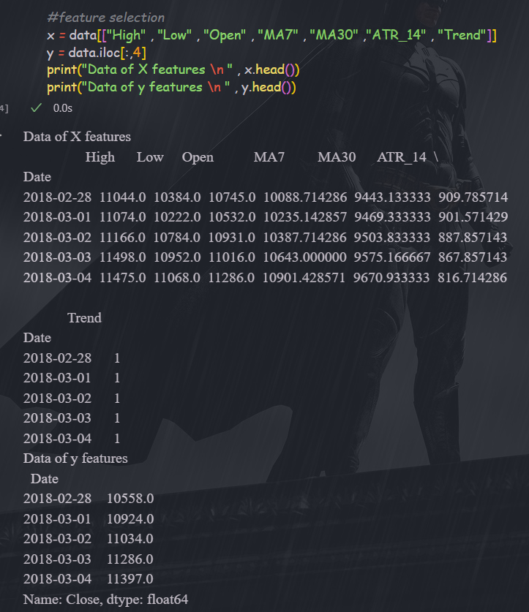
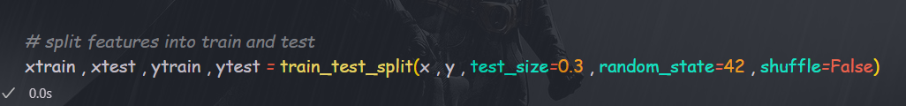
Feature selection and train-test split

Slide 38
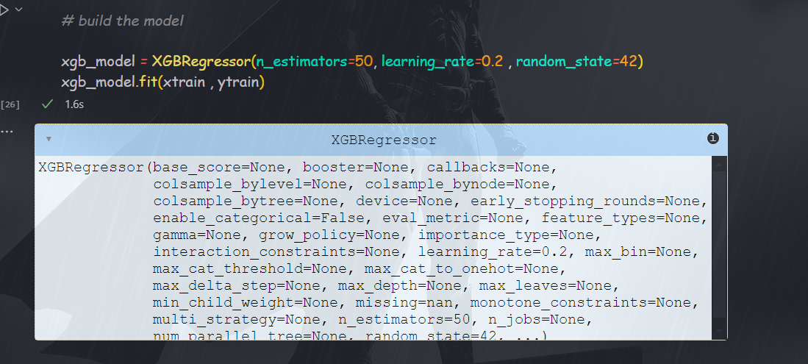
Build the XGBoost model

Slide 39
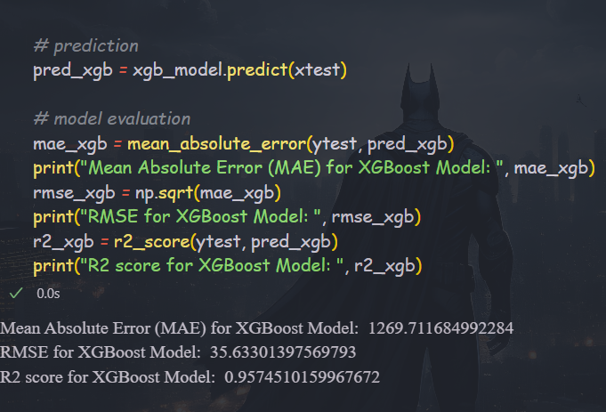
Evaluate the model
MAE = Since the average price is ~20,643, the MAE is only about 6.1% of the mean price, which is pretty good.
RMSE = This value seems surprisingly low given the high variability of BTC prices. it’s likely that this is scaled or normalized, but if this is the actual RMSE, it’s extremely good.
R2 = A score of 0.957 suggests that 95.7% of the variance is explained by your model, which is excellent.

Slide 40
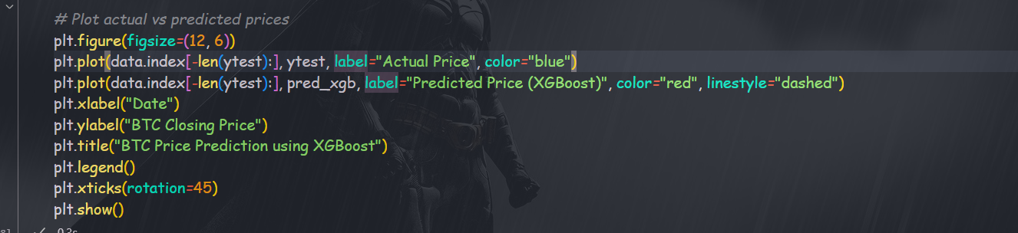
Visualize the predicated prices

Slide 41
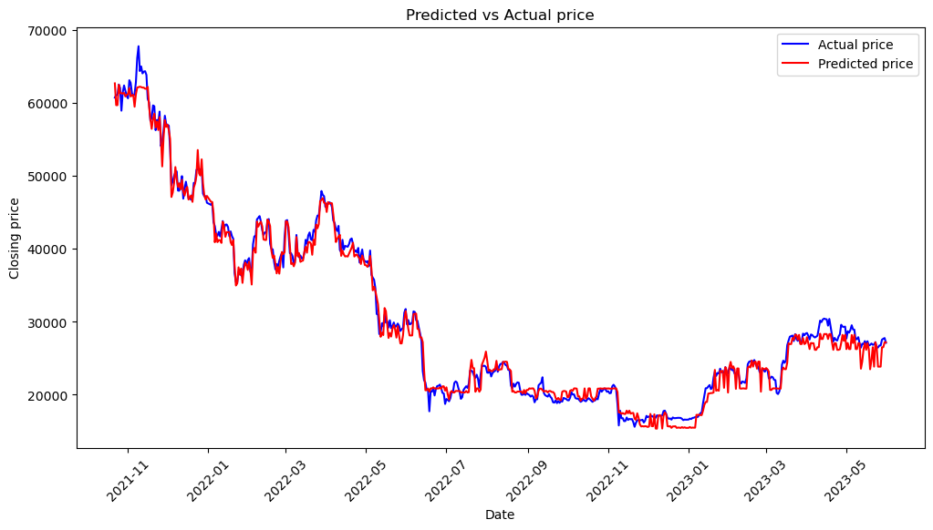

Slide 42

LSTM Model

Slide 43
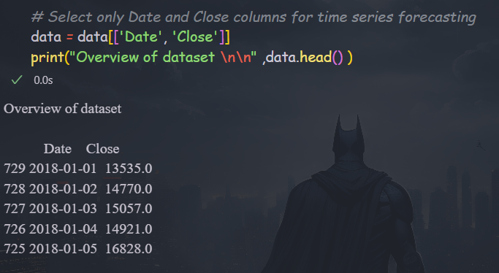
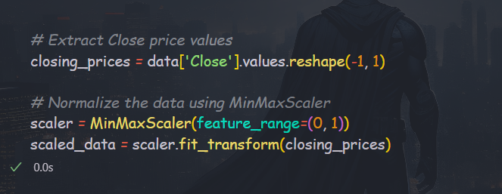
Feature selection and Data Scaling

Slide 44
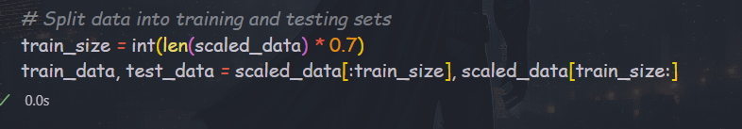
Training and Testing Dataset

Slide 45
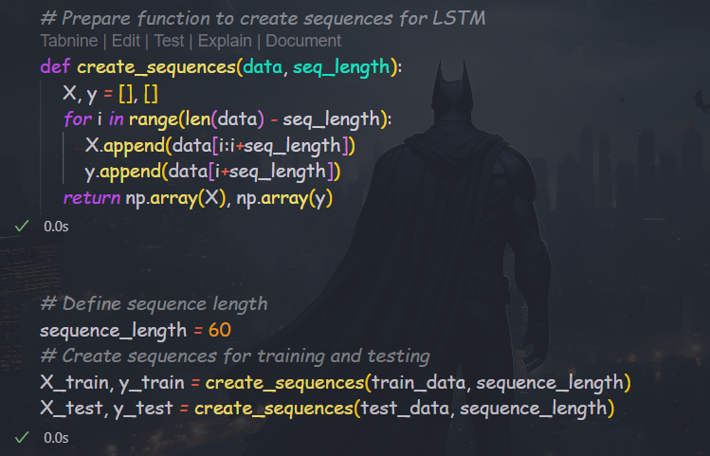
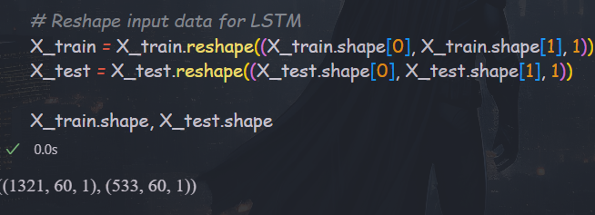
Sequences with length of 60 and reshape the data

Slide 46
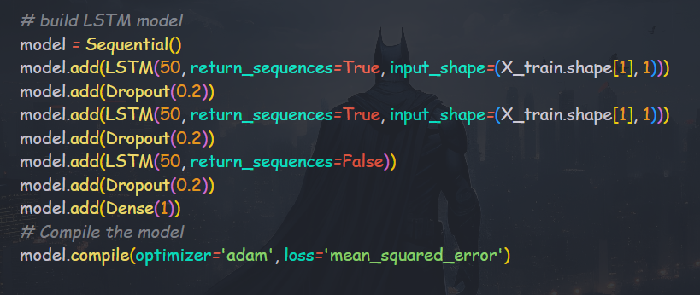
Model building

Slide 47
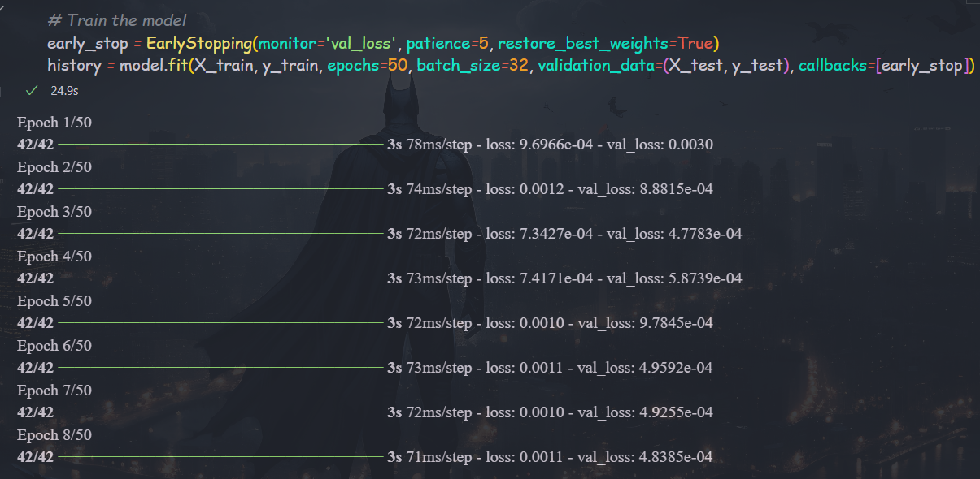
Fit the model with appropriate iterations

Slide 48
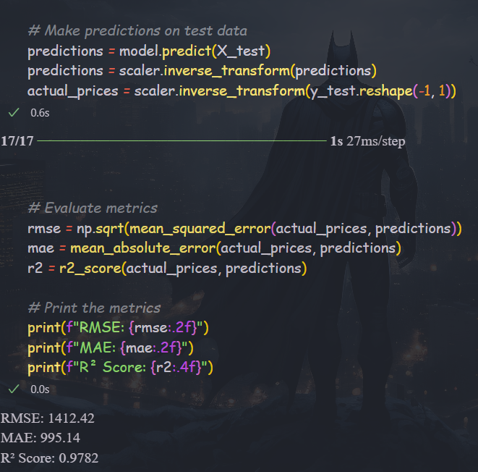
Predictions and model evaluation
Analysis:
RMSE (1454.90) indicates that, on average, the model’s predicted price deviates by about $1455 from the actual price. Since BTC prices can be highly volatile, this error is relatively small compared to the typical price range.
R2 score 0.9769 indicates that 97.7% of the variance in the BTC price is explained by the model.
Overall, the model is trained and performed well

Slide 49
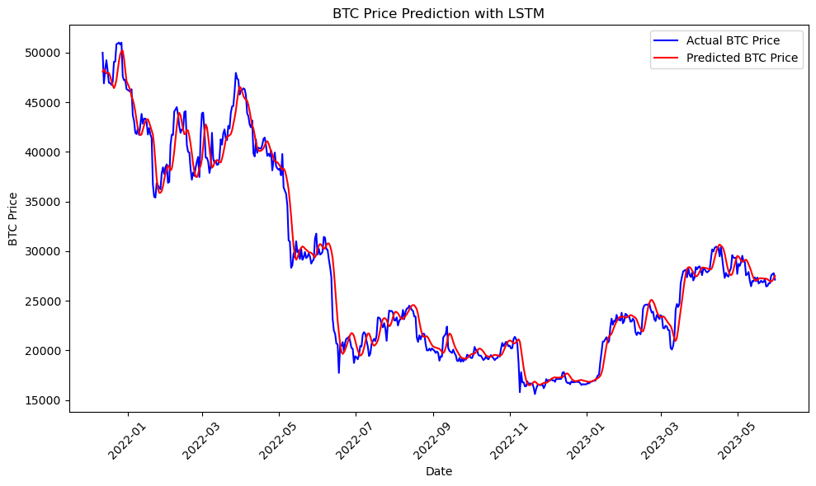
Predicated price vs Actual Price

Slide 50
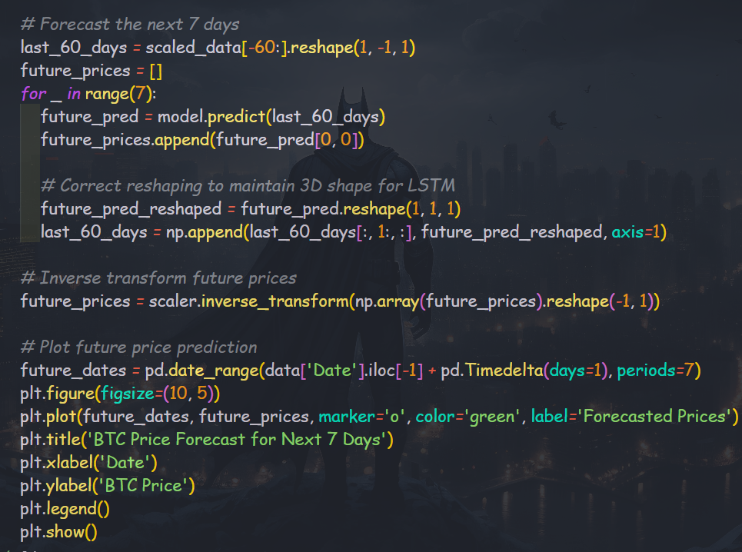
Price forecasting of 7 days based on last 60 days with LSTM

Slide 51
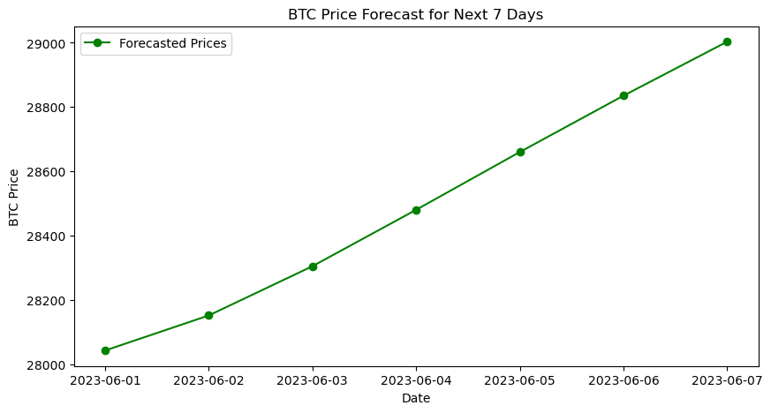

Slide 52
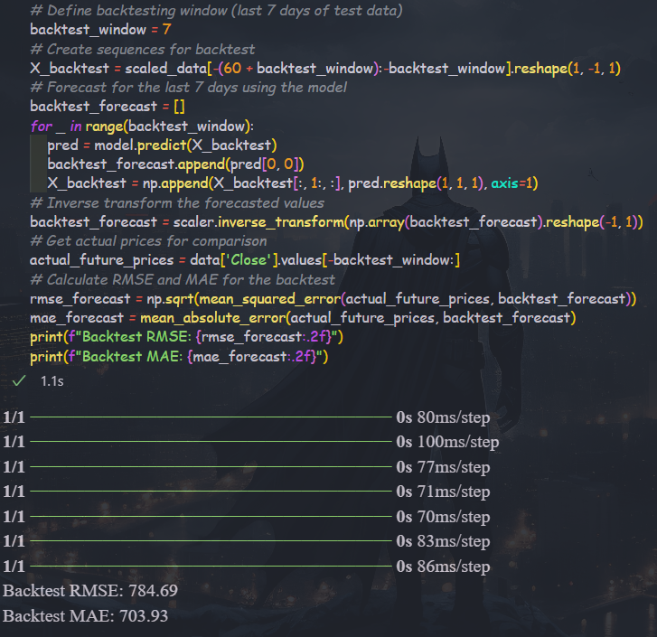
Verify the forecasting
Analysis:
RMSE= 784.69 suggests that, on average, the model’s forecast deviates by about $785 from the actual BTC price over the 7-day backtest period.
An RMSE below 800 for BTC price predictions over a 7-day period is a good indicator of reliability.

Slide 53
Model Comparison
XGBoost Model:
Fast and accurate for predicting trends and price changes.
Suitable for quick decision-making and broader market analysis.
LSTM Model:
Highly effective at capturing sequential price patterns.
Better suited for 7-day price forecasting with a high degree of reliability.

Slide 54
Conclusion
The predictive models (XGBoost and LSTM) have shown excellent performance in forecasting BTC prices.
XGBoost excels in explaining variance and handling price trends, while LSTM effectively predicts short-term price movements with minimal deviation.
Forecasting Accuracy: The RMSE of 784.69 for a 7-day forecast confirms that the model can be used to predict BTC price trends with a high degree of reliability.

Slide 55
THANKS!

